Slide 1
Hypothesis Testing with z tests
Arlo Clark-Foos

Slide 2
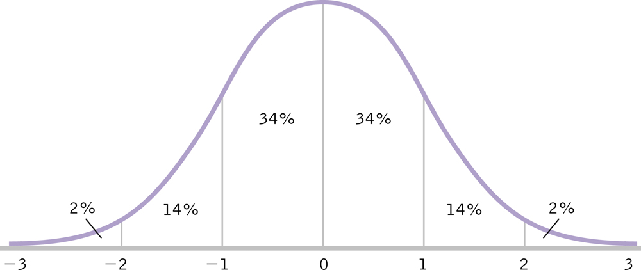
Review: Standardization
Allows us to easily see how one score (or sample) compares with all other scores (or a population).

Slide 3
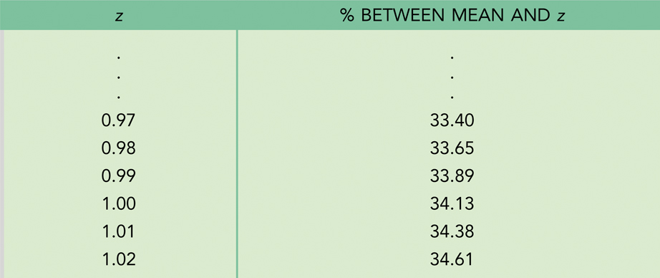
CDC Example: Jessica
Jessica is 15 years old and 66.41 in. tall
For 15 year old girls, μ = 63.8, σ = 2.66

Slide 4
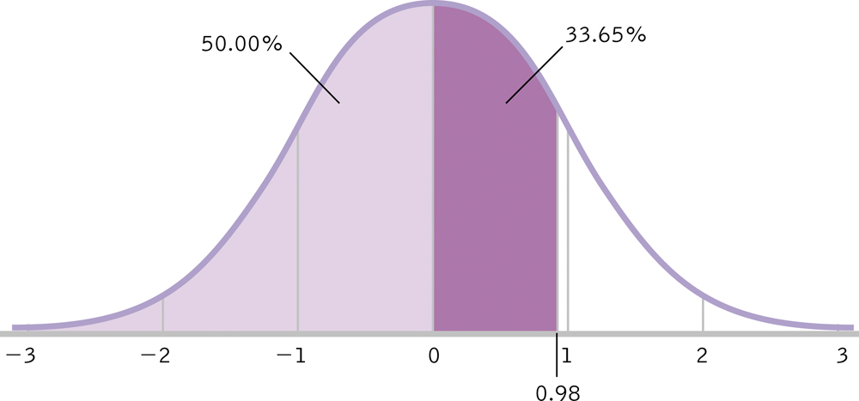
CDC Example: Jessica
1. Percentile: How many 15 year old girls are shorter than Jessica?
50% + 33.65% = 83.65%

Slide 5
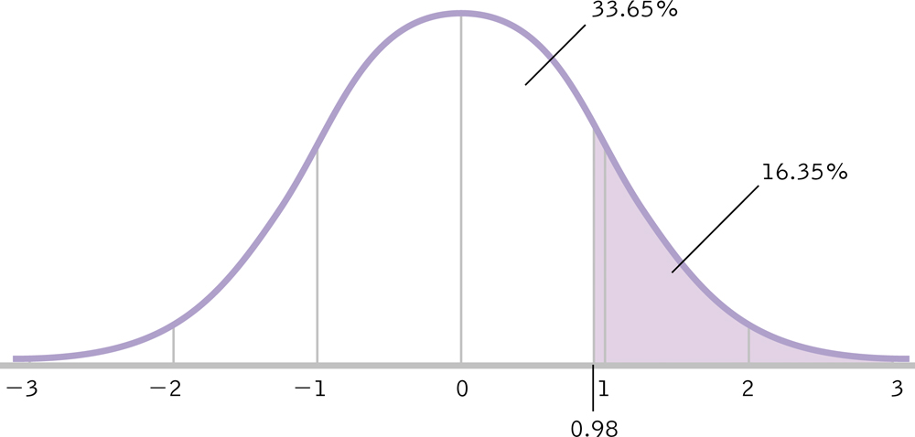
CDC Example: Jessica
2. What percentage of 15 year old girls are taller than Jessica?
50% - 33.65% OR 100% - 83.65% = 16.35%

Slide 6
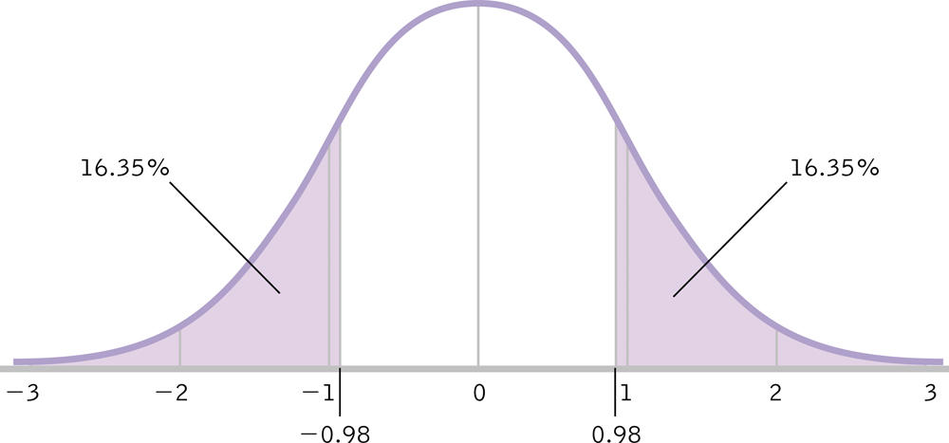
CDC Example: Jessica
3. What percentage of 15 year old girls are as far from the mean as Jessica (tall or short)?
16.35 % + 16.35% = 32.7%

Slide 7
CDC Example: Manuel
Manuel is 15 years old and 61.2 in. tall
For 15 year old boys, μ = 67, σ = 3.19
Consult z table for 1.82 → 46.56%

Slide 8
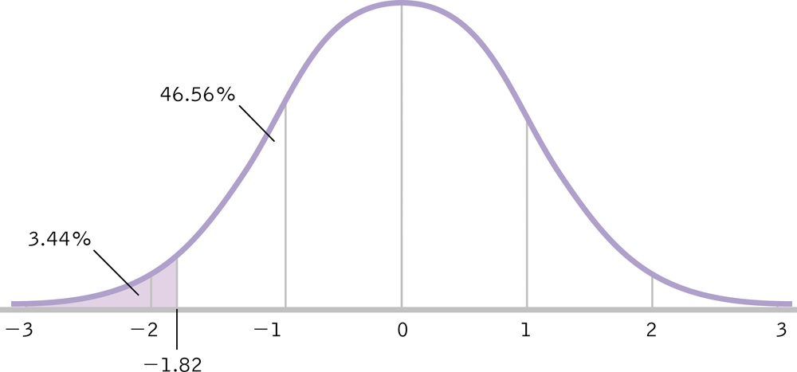
CDC Example: Manuel
1. Percentile
Negative z, below mean: 50% - 46.56% = 3.44%

Slide 9
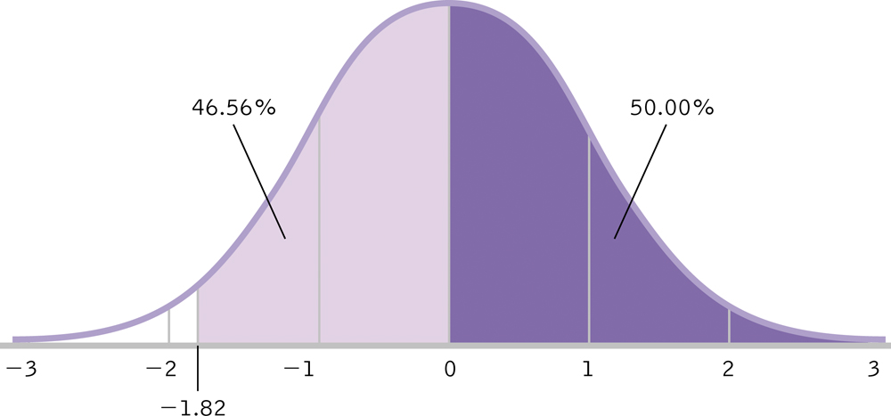
CDC Example: Manuel
2. Percent Above Manuel
100% - 3.44% = 96.56 %

Slide 10

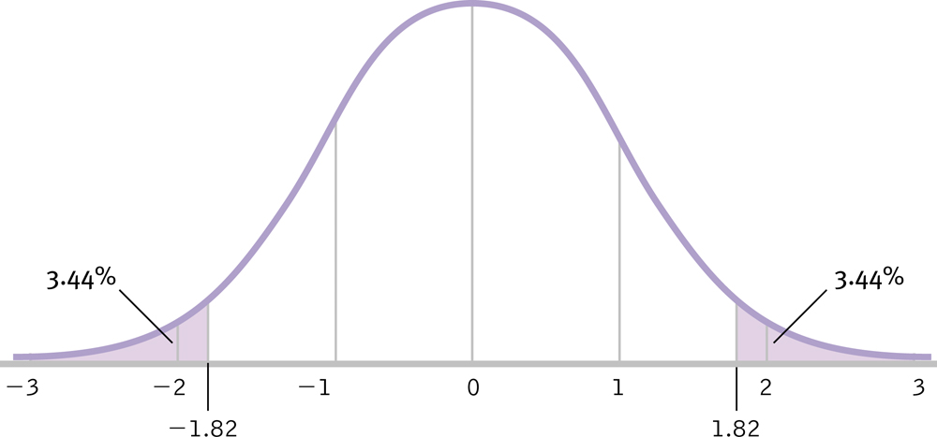
CDC Example: Manuel
3. Percent as extreme as Manuel
3.44% + 3.44% = 6.88%

Slide 11
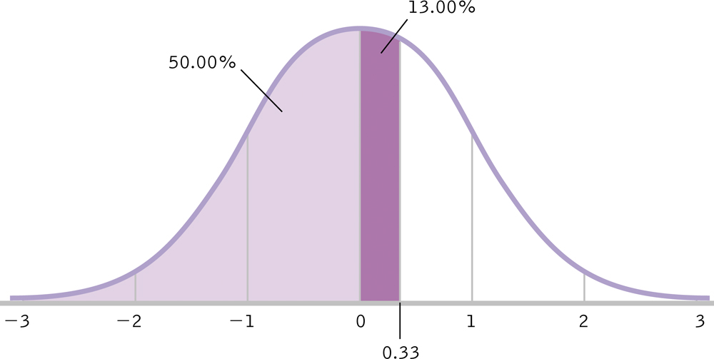
Percentages to z Scores
SAT Example: μ = 500, σ = 100
You find out you are at 63rd percentile
Consult z table for 13% →

Slide 12
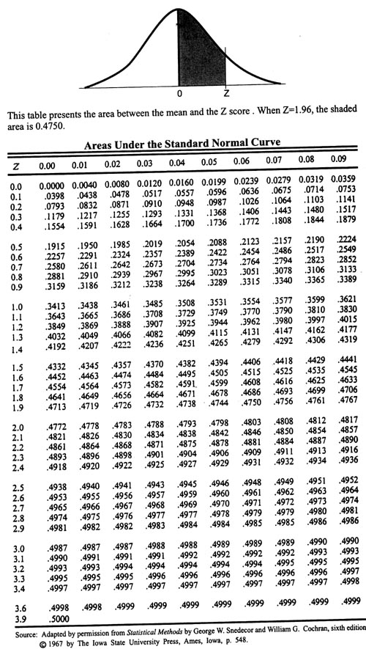
THIS z Table lists the percentage under the normal curve, between the mean (center of distribution) and the z statistic.
63rd Percentile = 63%
50% + 13%
z = ? _

Slide 13
Percentages to z Scores
SAT Example: μ = 500, σ = 100
You find out you are at 63rd percentile
Consult z table for 13% → z = .33
X = .33(100) + 500 = 533

Slide 14
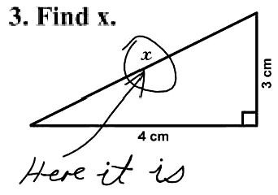

UMD & GRE Example
How do UMD students measure up on the older version of the verbal GRE? We know that the population average on the old version of the GRE (from ETS) was 554 with a standard deviation of 99. Our sample of 90 UMD students had an average of 568. Is the 14 point difference in averages enough to say that UMD students perform better than the general population?
Given in problem: μ_{M} = μ = 554, σ = 99 M = 568, N = 90
Remember that if we use distribution of means, we are using a sample and need to use standard error.

Slide 15
UMD & GRE Example
Given in problem: μ_{M} = μ = 554, σ = 99 M = 568, N = 90
Consult z table for z = 1.34

Slide 16
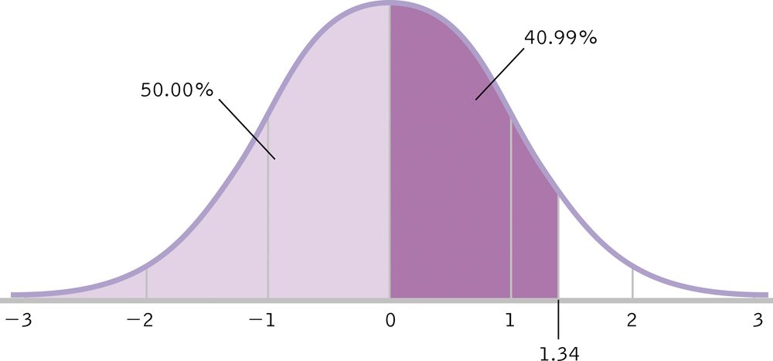
THIS z Table lists the percentage under the normal curve, between the mean (center of distribution) and the z statistic.
z = 1.34

Slide 17
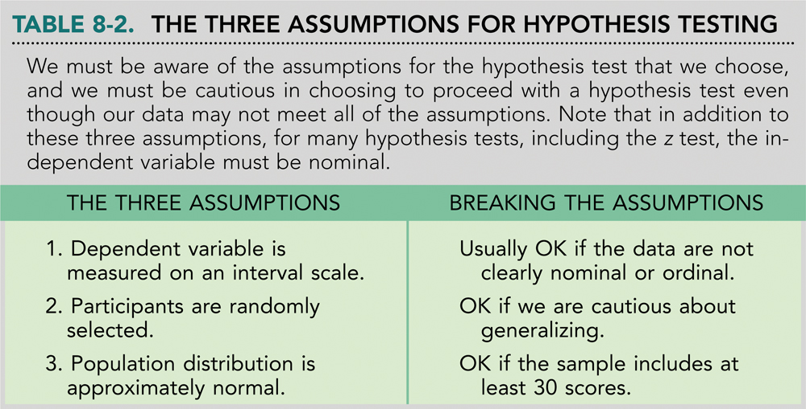
Assumptions of Hypothesis Testing

Slide 18
Assumptions of Hypothesis Testing
The DV is measured on an interval scale
Participants are randomly selected
The distribution of the population is approximately normal
Robust: These hyp. tests are those that produce fairly accurate results even when the data suggest that the population might not meet some of the assumptions.
Parametric Tests (we will discuss)
Nonparametric Tests (we will not discuss)

Slide 19
Testing Hypotheses
Identify the population, comparison distribution, inferential test, and assumptions
State the null and research hypotheses
Determine characteristics of the comparison distribution
Whether this is the whole population or a control group, we need to find the mean and some measure of spread (variability).

Slide 20
Testing Hypotheses (6 Steps)
Determine critical values or cutoffs
How extreme must our data be to reject the null?
Critical Values: Test statistic values beyond which we will reject the null hypothesis (cutoffs).
How far out must a score be to be considered ‘extreme’?
p levels (α): Probabilities used to determine the critical value
Calculate test statistic (e.g., z statistic)
Make a decision
Statistically Significant: Instructs us to reject the null hypothesis because the pattern in the data differs from what we would expect by chance alone.

Slide 21
The z Test: An Example
Given: μ = 156.5, σ = 14.6, M = 156.11, N = 97
Populations, distributions, and assumptions
Populations:
All students at UMD who have taken the test (not just our sample)
All students nationwide who have taken the test
Distribution: Sample → distribution of means
Test & Assumptions: z test
Data are interval
We hope random selection (otherwise, less generalizable)
Sample size > 30, therefore distribution is normal

Slide 22
The z Test: An Example
State the null (H₀) and research (H₁)hypotheses
In Symbols…
In Words…
H₀: μ₁ ≤ μ₂
H₁: μ₁ > μ₂
OR
H₀: μ₁ = μ₂
H₁: μ₁ ≠ μ₂
H₀: Mean of pop 1 will be less than or equal to the mean of pop 2
H₁: Mean of pop 1 will be greater than mean of pop 2
H₀: Mean of pop 1 will be less equal to the mean of pop 2
H₁: Mean of pop 1 will be different from the mean of pop 2

Slide 23
The z Test: An Example
Determine characteristics of comparison distribution.
Population: μ = 156.5, σ = 14.6
Sample: M = 156.11, N = 97

Slide 24
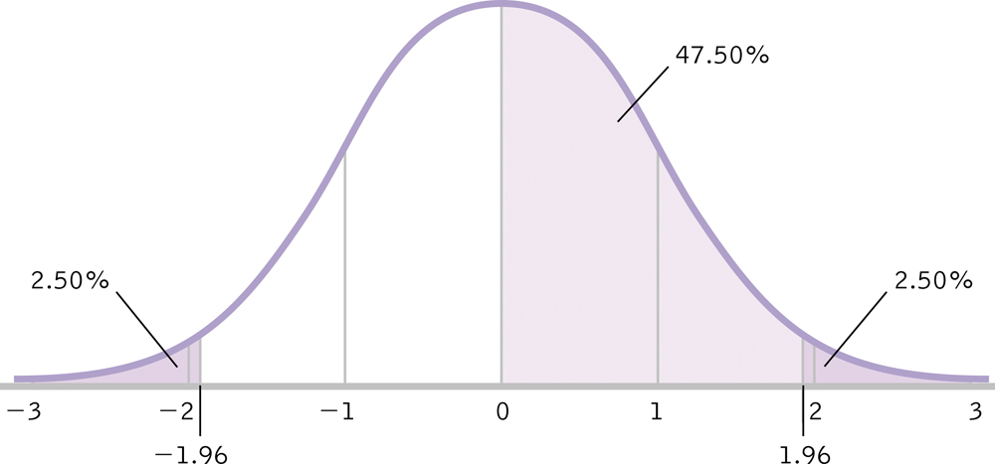
The z Test: An Example
Determine critical value (cutoffs)
In Behavioral Sciences, we use p = .05
p = .05 = 5% → 2.5% in each tail
50% - 2.5% = 47.5%
Consult z table for 47.5% → z = 1.96

Slide 25
THIS z Table lists the percentage under the normal curve, between the mean (center of distribution) and the z statistic.
95% / 2 = 47.5%
z_{crit} = 1.96

Slide 26
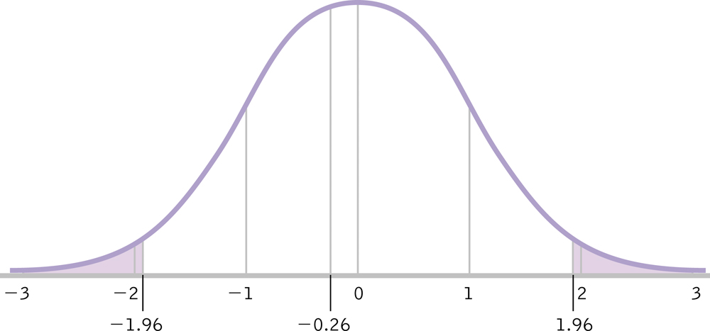
The z Test: An Example
Calculate test statistic
Make a Decision

Slide 27
Does sample size matter?

Slide 28
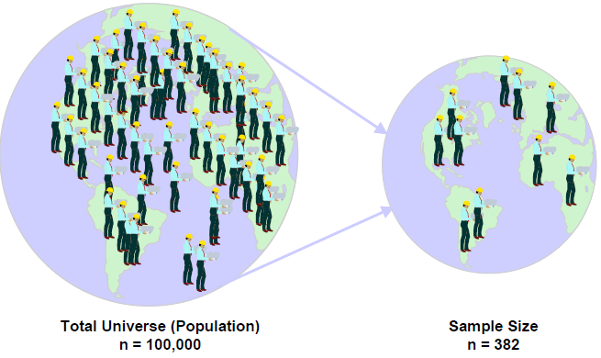
Increasing Sample Size
By increasing sample size, one can increase the value of the test statistic, thus increasing probability of finding a significant effect

Slide 29
Why Increasing Sample Size Matters
Original Example: Psychology GRE scores
Population: μ = 554, σ = 99
Sample: M = 568, N = 90

Slide 30
Why Increasing Sample Size Matters
New Example: Psychology GRE scores for N = 200
Population: μ = 554, σ = 99
Sample: M = 568, N = 200

Slide 31
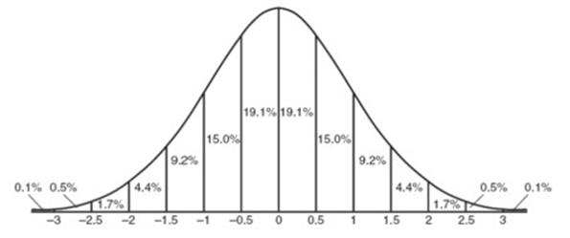
Why Increasing Sample Size Matters
μ = 554, σ = 99, M = 568
N = 90
μ = 554, σ = 99, M = 568
N = 200
z = 1.34
z = 2.00
z_{critical (p=.05)} = ±1.96
Not significant,
fail to reject null hypothesis
Significant,
reject null hypothesis

Slide 32
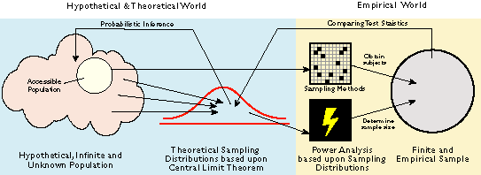
Summary Graphic
http://www.creative-wisdom.com/computer/sas/parametric.gif

Slide 33
Shall we review?
Random Selection (Approx.)
Observed Data = Chance events
Normally Distributed
Most of us are average, or very near it
Probability of Likely vs. Unlikely Events
Statistical Significance
Inferring Relationship to Population
What is the probability of obtaining my sample mean given some information about the population?

Slide 34

Does a Foos live up to a Fuβ?
When I was growing up my father told me that our last name, Foos, was German for foot (Fuβ) because our ancestors had been very fast runners. I am curious whether there is any evidence for this claim in my family so I have gathered running times for a distance of one mile from 6 family members. The average healthy adult can run one mile in 10 minutes and 13 seconds (standard deviation of 76 seconds). Is my family running speed different from the national average?
Person | Running Time
Paul | 13min 48sec
Phyllis | 10min 10sec
Tom | 7min 54sec
Aleigha | 9min 22sec
Arlo | 8min 38sec
David | 9min 48sec
…in seconds
828sec
610sec
474sec
562sec
518sec
588sec
∑ = 3580
N = 6
M = 596.667

Slide 35
Does a Foos live up to a Fuβ?
Given: μ = 613sec , σ = 76sec, M = 596.667sec, N = 6
Populations, distributions, and assumptions
Populations:
All individuals with the last name Foos.
All healthy adults.
Distribution: Sample mean → distribution of means
Test & Assumptions: We know μ and σ , so z test
Data are interval
Not random selection
Sample size of 6 is less than 30, therefore distribution might not be normal

Slide 36
Does a Foos live up to a Fuβ?
Given: μ = 613sec , σ = 76sec, M = 596.667sec, N = 6
State the null (H₀) and research (H₁)hypotheses
H₀: People with the last name Foos do not run at different speeds than the national average.
H₁: People with the last name Foos do run at different speeds (either slower or faster) than the national average.

Slide 37
Does a Foos live up to a Fuβ?
Given: μ = 613sec , σ = 76sec, M = 596.667sec, N = 6
Determine characteristics of comparison distribution (distribution of sample means).
Population: μ_{M} = μ = 613.5sec, σ = 76sec
Sample: M = 596.667sec, N = 6

Slide 38
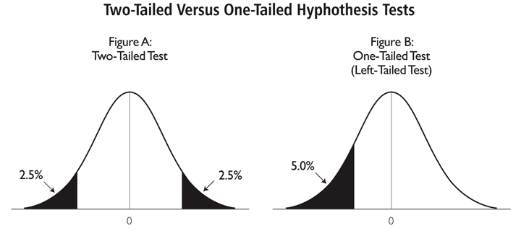
Does a Foos live up to a Fuβ?
Given: μ = 613sec , σ_{M} = 31.02sec, M = 596.667sec, N = 6
Determine critical value (cutoffs)
In Behavioral Sciences, we use p = .05
Our hypothesis (“People with the last name Foos do run at different speeds (either slower or faster) than the national average.”) is nondirectional so our hypothesis test is two-tailed.

Slide 39
THIS z Table lists the percentage under the normal curve, between the mean (center of distribution) and the z statistic.
5% (p=.05) / 2 = 2.5% from each side
100% - 2.5% = 97.5%
97.5% = 50% + 47.5%
z_{crit} = ±1.96
-1.96
+1.96

Slide 40
IF it were One Tailed…
THIS z Table lists the percentage under the normal curve, between the mean (center of distribution) and the z statistic.
100% - 5% (p=.05) = 95%
95% = 50% + 45%
z_{crit} = 1.65
1.65

Slide 41
Does a Foos live up to a Fuβ?
Given: μ = 613sec , σ_{M} = 31.02sec, M = 596.667sec, N = 6
Calculate test statistic
Make a Decision

Slide 42
Does a Foos live up to a Fuβ?
Given: μ = 613sec , σ_{M} = 31.02sec, M = 596.667sec, N = 6
Make a Decision
z = -.53 < z_{crit} = ±1.96, fail to reject null hypothesis
The average one mile running time of Foos family members is not different from the national average running time…the legends aren’t true

Slide 43
Feel comfortable yet?
Could you complete a similar problem on your own?
Could you perform the same steps for a one-tailed test (i.e., directional hypothesis)?
Are you comfortable with the concept of p-value (alpha level) and statistical significance?
Can you easily convert back and forth between raw scores, z scores/statistics, and percentages?
If you answered “No” to any of the above then you should be seeking extra help (e.g., completing extra practice problems, attending SI sessions, coming to office hours or making appt. with professor).

